Slide 1
This document is intended for internal use only.
The Global Generative AI Clearinghouse will provide updated documents frequently – the latest versions can be found on the Deloitte Generative AI KX page.
Due to the complexity of the topic (independence, security, trust), please handle this topic with caution.
For additional questions, after reviewing provided documents, please reach out to the Clearinghouse.
Note: Microsoft / OpenAI are designated Restricted Entity, Technology Services Relationship
Generative AI Fact Pack
May 30, 2023
Version 2.0

Slide 2
Change Log
VERSION | DATE LAST UPDATED | CHANGES MADE
1.9 | 2/8/2023 | Created initial version of fact pack
2.0 | 5/30/2023 | Updated latest market stats Refreshed flow and key content (including, tech stacks, market opportunity, competitor analysis) Refined key Deloitte E&A partners

Slide 3

Table of Contents | Generative AI
1
Market Opportunity
2
Generative AI Demystified
3
Market Plays
4
Appendix: Competitor Summary and Detailed Market Plays

Slide 4

Generative AI Market Opportunity

Slide 5
All Signals Indicate that AI Market Growth is Turbo Charging
Artificial Intelligence (AI) encompasses many technologies that work together to build innovative solutions that transform society and business.
Economic Impact
AI augmentation will reach $4.7 trillion of business value by 2024 –Gartner¹
Artificial General Intelligence (AGI)
AI Simulation
Generative AI
Conversational AI
Quantum
Worldwide Revenues
Autonomous Systems
Global revenues for AI-related software, hardware, and services is forecasted to surpass $900B in 2026, representing a 18.6% five-year CAGR²
Deep Learning
Vision AI
Virtual Assistants
Speech Recognition
Machine Learning
Enterprise Application
79% of leaders reported full-scale deployment for three or more types of AI applications – a 17% increase from 62% in 2021³
Predictive Analytics
Intelligent Automation
¹ Gartner, AI Augmentation Business Value
² IDC Worldwide Semiannual Artificial Intelligence Tracker
³ State of AI in the Enterprise, 5th Edition, Deloitte

Slide 6




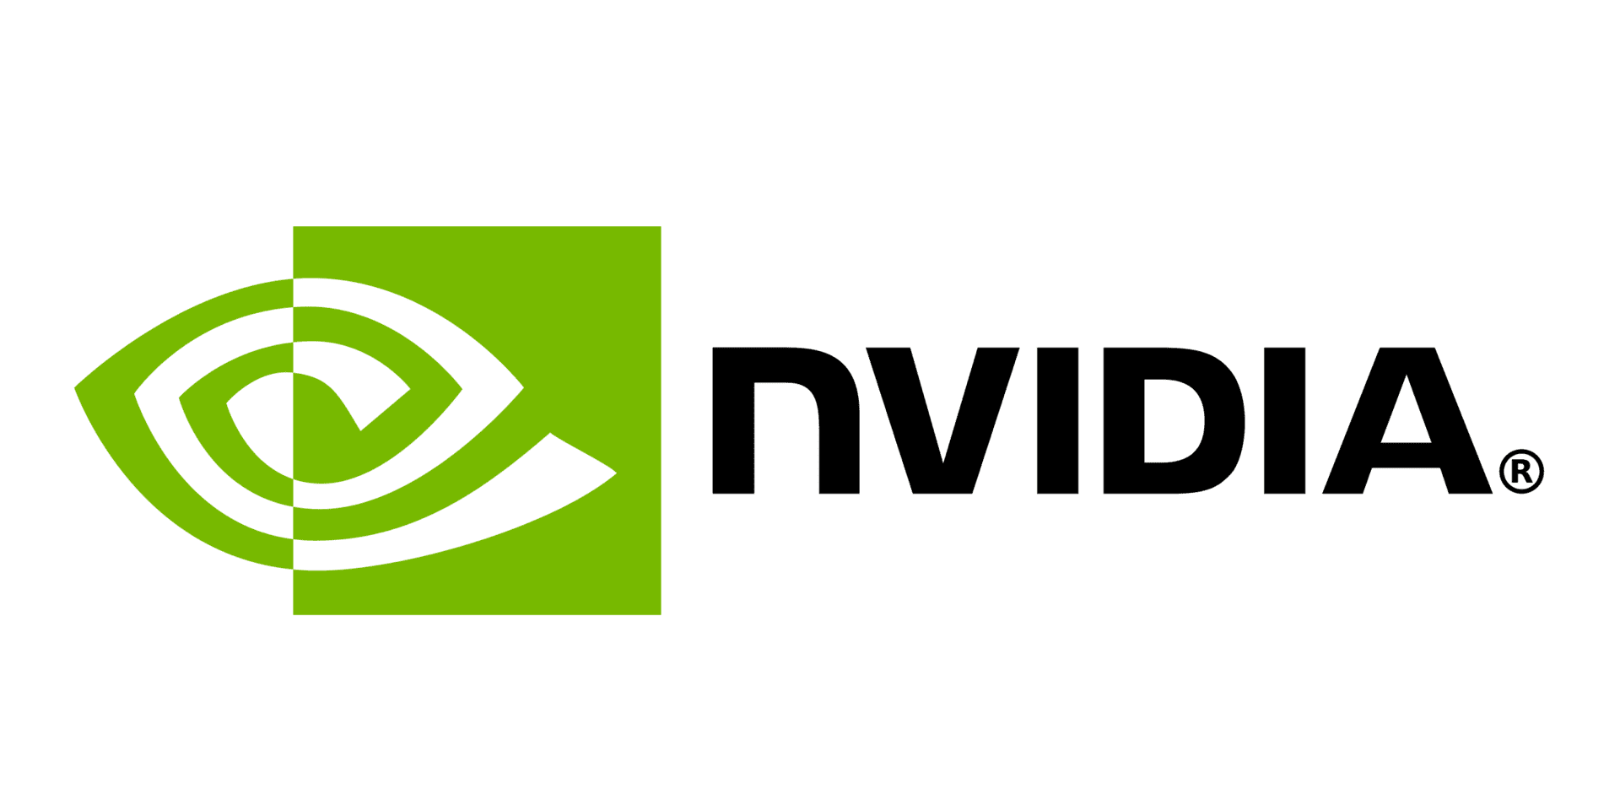



Generative Models Deliver Greatest Business Value for Use Cases that Represent More Human-like Tasks
Increasing Complexity
 | MACHINE LEARNING MODELS |  |  | DEEP LEARNING MODELS |  |  | GENERATIVE MODELS
Primary Use & Major Enterprise Players | Identify patterns and co-relationships in data e.g., pattern detection, data driven insights, trends |  |  | Reduce complexity and make inferences e.g., image recognition, human language understanding, recommendations |  |  | Generate human-like capabilities (e.g., speech, vision) e.g., generating content, human language generation, reason-based decisioning
Client's Role | Build models | Deploy models | Manage models | Partner to adapt models | Train models | Deploy and manage models | Tune models | Deploy models | Manage models
Deloitte’s Example Market Plays | CortexAI^{TM*}| Host AI models in platform environment GPS AI Engines | ML Models to deliver insights at scale AIOPS.DTM | Automate business processes InsightsCloud | Deliver strategic market insights |  |  | TrueServeTM | Conversational AI for Digital Contact Center Unlimited RealityTM | Design/build metaverse environment Autonomous Mobility | Simulate autonomous navigation Zero Based Infrastructure | Smart retail operations |  |  | Autonomous Coding | Autonomous software engineering AI-Enabled Drug Discovery | Simulate life sciences R&D
Deloitte’s Value Add
*
*
*
ReadyAITM | AI pods to operationalize models at scale
Demonstrate value through POCs
Capacity to build and deploy ML models at scale
Operationalize models at scale (MLOps)
Develop functional use cases
Train and deploy models jointly with partners
Operate business solutions
Prioritize right partners and identify optimal models
Tune models on enterprise information
Run AI Factory for LLM-Ops
*Restricted Entity, Technology Services Relationship

Slide 7

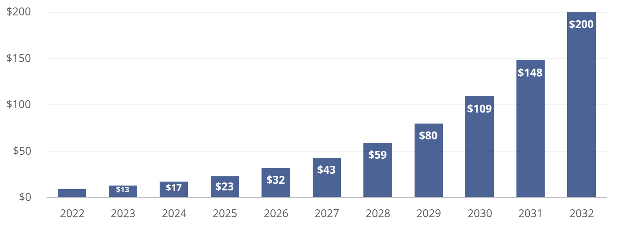

Generative AI is Creating Disruption Calling for Businesses to Re-Vector
GENERATIVE AI IS AN IPHONE MOMENT
BUSINESS MODELS WILL BE CHALLENGED
ORGANIZATIONS WILL NEED TO ADAPT
$1 TRILLION¹…
CROSS-INDUSTRY SOLUTIONS…
OPERATING MODELS…
…is the scale of near term global economic disruption due to accelerated innovation
…are enabling autonomous processes and enhancing workforce productivity
…across core business units (e.g., sales, R&D) and enabling areas (e.g., finance, IT)
Top Occupations Exposed to AI³
Generative AI market to
reach $200B by 2032 (CAGR +36.10%)²
6 of the top 20 occupations that will be impacted are relevant to Deloitte, including:
Financial Managers
Actuaries
Management Analysts
Budget Analysts
Accountants and Auditors
Compensation, Benefits, and Job Analysis Specialists
“The world is experiencing one of the most profound technological shifts with the rise of generative AI...as companies connect with their customers in more intelligent, automated, and personalized ways,”
- Marc Benioff, CEO
¹ Statista Digital Market Outlook - Segment Report (Digital Advertising Report 2022 - Search Advertising); Digital Content Market Size, Share, Growth & Trends Analysis Report By Type, Application, and Segment Forecasts, 2021 to 2027; Application Development Software Global Market Report 2023
² Newswire, Generative AI Global Market Report 2023
³ Felten, Edward W. and Raj, Manav and Seamans, Robert, How will Language Modelers like ChatGPT Affect Occupations and Industries?

Slide 8

Generative AI is at the Forefront of Democratizing AI
Everyone is a Creator
Intelligent Assistants for Everyone
Generative AI
Generative AI enables everyone to generate complex text, art, music – even code
There has been an explosion in the amount and variety of content created by AI
Output and experiences are customized to each unique interaction or user
Improvement of human-computer interactions
Scaling of multi-modal (e.g., text, audio) and universal (translate) abilities in assistants
Acceleration of understanding of global information
Text
AI-Power to the Masses
Self-Programming Machines
Adaptation to new ways of work (e.g., ‘”Everyone is a Prompt Engineer”)
Distribution of AI insights to users through low-code and no-code platforms (e.g., ChatGPT)
Utilization of improved developer capabilities (e.g., no longer need to search syntax or debug code)
Machines program minor updates autonomously
Democratizing AI
Applications

Slide 9
Generative AI Demystified

Slide 10
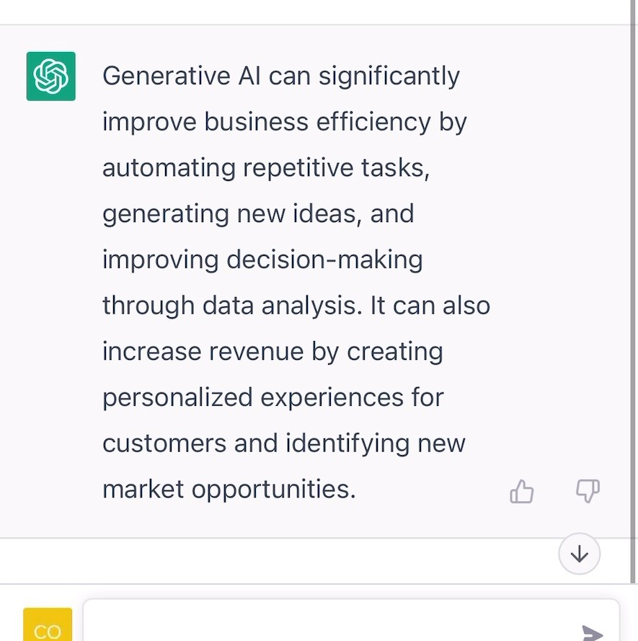

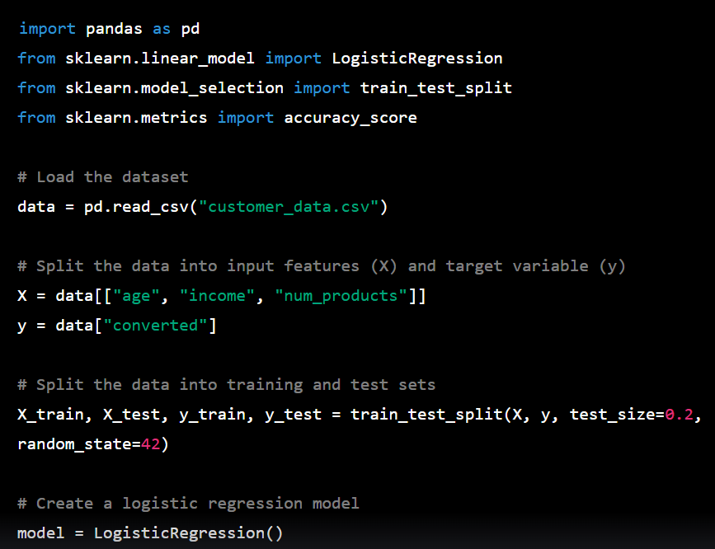

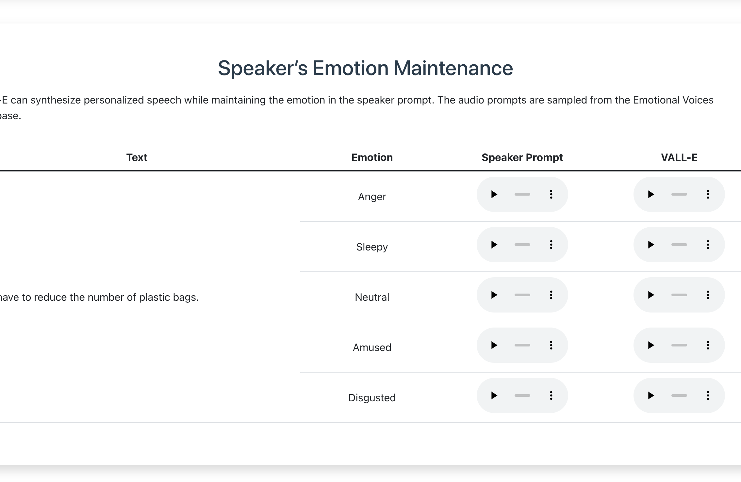
Unlocking the Power of Language: Understanding Generative AI
EXAMPLE MODALITIES
Text Generation
Prompt: Explain my colleagues the business impact of generative AI in 50 words
WHAT is Generative AI | artificial intelligence that creates original content across various modalities (e.g., text, images, audio, code, voice, video) that would have previously taken human skill and expertise to create
HOW does it work | Generative AI is powered by foundation models such as OpenAI’s GPT-4 , NVIDIA’s Megatron, and Google’s PaLM, which are trained on vast amounts of data and computation to perform a broad range of downstream tasks
Image Generation
Prompt: A bowl of soup that is a portal to another dimension as digital art
WHY now | innovations in machine learning and the cloud tech stack, coupled with the viral popularity of publicly released applications have propelled Generative AI into the zeitgeist
Code Generation
Prompt: In python, code a program that predicts the likelihood of customer conversion
WHO is involved | Big Tech is building—and enabling access to—foundation models; start-ups are developing user applications on these underlying models; and companies are beginning to adopt
Video Generation
Prompt: A teddy bear painting a portrait
POTENTIAL BUSINESS IMPACT| the marginal cost of producing initial versions of knowledge-intensive content—such as IT code, marketing copy, and creative design—can decrease significantly
Audio Generation
Prompt: Play ‘we have to reduce the number of plastic bags’ in a sleepy tone

Slide 11
FOR INTERNAL USE ONLY
The Mechanics of Generative AI: A Simplified View
Sample Terms:
Applications…what we see
OpenAI’s ChatGPT and other applications generate content across various modalities (e.g., text, image, video, audio, etc.) based on how the underlying model was trained.
1. Model A neural network that has been trained to generate outputs given an input prompt
2. Fine-Tuning Shaping leading Foundation Models to become fit-for-purpose applications across industries and domains
3. Prompt Engineering The art of making / adjusting the prompt for the model to output an optimal answer
4. Adversarial Training Pit two different deep-learning models against each other in a game for training
5. Tokenization The process of splitting text into smaller units and mapping to vectors and fed into models
6. Parameters Level of understanding about each word and context within the training data sets
7. Transformer Model Model that can ‘transform’ generic words into context-aware representations Google & U. of Toronto invented in 2017
8. Diffusion Model Construction of high-resolution images from noise. Mostly used in speech-to-image / text-to-image models
OUTPUT
Generative AI Application
Why do these applications seem so human?
Similar to traditional AI, Foundation Models are models¹ that predict outputs based on inferences on the inputs it receives. However, through, fine-tuning², prompt engineering³ and adversarial training⁴ these models generate outputs based on its understanding of human communication.
PREDICTION
Generative AI Models
What are Foundation Models?
OpenAI’s GPT-4 is one example of a Foundation Model, specifically a large language model which uses deep learning to process huge amounts of data to form ‘memories’ on the input datasets through tokenization⁵, thereby shaping the model’s parameters⁶. There are common Foundation Model architectures (e.g., Transformer⁷, Diffusion⁸) which drive the modalities for each model.
MODELS
Cloud & Data Platforms
Training on the world’s knowledge
Foundation Models are trained on petabytes worth of global data to shape understanding, tone, and behavior while considering human communication styles.
AI Infrastructure
DATA
COMPUTE POWER
Powering our journey to tomorrow
The scale of compute capacity required to train and process Foundation Models necessitates the usage of leading GPUs (e.g., A100 NVIDIA) and TPUs (e.g., Google TPU v4) on scalable infrastructure.

Slide 12




FOR INTERNAL USE ONLY
How Do Applications Work? | Example: Chat GPT
USER INPUT
PROMPT
Imagine GPT as an infant… learning how to talk. The infant first learns basic patterns of how to talk from their parents, in this case, from the Internet.
Although it is generally very smart, ChatGPT, similar to infants, would output comments that contain misinformation, biases, or information that users were not looking for. Users then give feedback to course correct. It is a constant loop of users giving feedback, as the GPT improves the quality of output.
Judgement and edit are crucial steps for humans, as we address the alignment problem: how do we create a model that reduces the number of biases and that aligns with our human values of what we’d want the world to look like?
TRAINING
ChatGPT went to school. Textbook: Any information on the web including Wikipedia, web pages etc. excluding most recent data
Just as you would in Google Search, type in what you’d want to know / do for you
E.g., “How do I make pancakes?” “Write a poem for valentine’s day in the tone of Woody Allen”
GPT OUTPUT
GPT will answer your question / request
E.g., ”First you put 100g of flour…” “Roses are red…etc”
USER FEEDBACK
!
Specify or modify the prompt or give a thumbs up / down feedback to rate the output. Currently, the specificity of the prompt determine the quality of output*
E.g., “How do I make pancakes for a calorie conscious mom with no eggs in the fridge?”
GPT UPDATED OUTPUT
*The degree in which output differs based on the quality of prompt is so much so that there is now a word ‘prompt engineer’ who comes up with creative prompts to get an optimal output. CEO of OpenAI, Sam Altman predicts such term will not be relevant in 5 years as the GPT will have improved that the quality of output is less dependent on the quality of input.
GPT will provide you with, hopefully, an answer closer to what you want
USER EDIT / JUDGEMENT
Make the judgement on the quality of content (text, image etc.) and modify the prompt again or edit as needed

Slide 13
Generative AI Technical Stack
Generative AI High Level Architecture
Technical Considerations
Product Embedded Solutions
e.g., MS Teams
MS Bing
MS Azure,
Google Workplace,
Adobe Express,
Daydream (Mixtiles),
AI image generator (Shutterstock)
End to End Apps
e.g., V5 (Midjourney), Gen-2 (Runway)
Standalone Apps
e.g., Copilot (GitHub), Jasper.ai (Jasper)
Generative AI Applications
Application Frameworks coordinate the training of models across servers during pre-training, and fine-tuning for specific tasks, industries, and domains
Data platforms are used to store and manage the ‘big data’ required to train these models
Efficient communication between GPUs is crucial for fast training, achieved through libraries (e.g., NVIDIA CUDA)
GPU-enabled cloud computing platforms provide the required infrastructure and services to run generative AI models
Fine-Tuning and Training Frameworks*
e.g., NeMo Megatron (NVIDIA)
DeepSpeed (Microsoft)
Ray (OpenAI)
Foundation Models
Large Scale Pre-Trained Models Exposed via API
e.g., Megatron (NVIDIA), GPT-4 (OpenAI), AlphaFold (DeepMind)
Generative AI Models
Data Platforms | Databricks, Snowflake, Google BigQuery, AWS S3, Azure Synapse
Cloud & Data Platforms
Hyperscalers | Google Cloud, MS Azure, AWS, Oracle Cloud
NVIDIA CUDA + NVIDIA Collective Communication Library
AI Infrastructure
NVIDIA GPUs | A100, H100; Google Cloud TPUs | TPU v4
* Imperative for Deloitte to develop new capabilities around fine-tuning

Slide 14
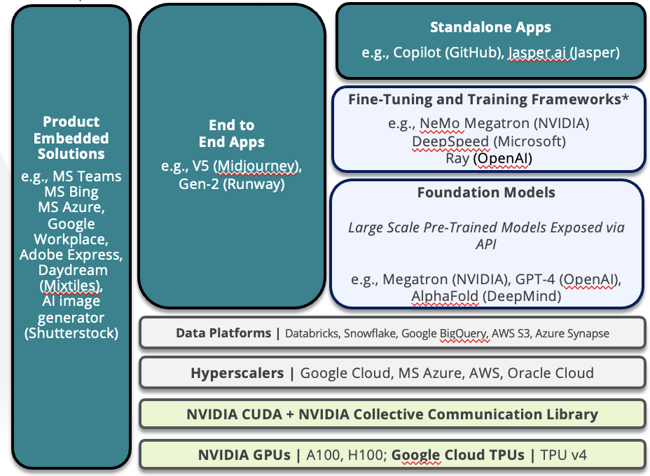
Tech Stack Deep Dive: Applications / Products
Applications
How is it Used?
What It Takes To Win
What is it? Represents a range of possible solutions that leverage the power of artificial intelligence to autonomously generate content, enhance human reasoning and accelerate productivity across various domains
Why is it important? Combines Generative AI and other forms of AI to offer significant efficiency, new strategy identification, and data-driven decision-making in businesses
Why is it disruptive? Enhances processes previously reliant on human expertise, accelerates innovation cycles, enables scalable personalization, and creates new value propositions, ultimately challenging established market positions
Examples TurboCode Bing Chat Jasper
Winners of the Generative AI paradigm are those who use it as a feature, not the solution. Generative AI alone has its inherent limitations, however when combined with Discriminative AI, Graph Neural Networks, and recursion organizations will operate with new levels of productivity and precision.
Adoption will accelerate as: Applications achieve core objectives, in an efficient and cost-effective manner Sources can be cited and rationale for outputs can be interpreted to support decisions Outputs offer a significant level of accuracy and reliability
Build capabilities in product development which encompasses all three forms of AI for interpretability, efficiency and precision.
Discriminative AI Precision & Forecasting
Explainable AI Interpretability & Trust
Generative AI Execution & Exploration
Example Flow
PRE-PROCESSING
FOUNDATION MODEL
POST-PROCESSING
Input
Use case and application specific inputs to trigger output
Preparation
Assess moderation policies and define context
Precision
What type of inputs are needed to generate outputs?
FM Prompting
Translated user intent
Model instructions
Processing & Response Generation
Design application / foundation model interactions
Generates a series of outputs based on tailored prompts from application
Filtering and Ranking of Outputs
AI ranks accuracy / relevance of outputs
(e.g. Out of 1000 strategy scenarios, output 5-10)
Alignment with Rules & Expectations
Is response appropriate?
Is each scenario explainable?
What are the key features driving each output / ranking?
Outputs
Show decision rationale, show level of confidence for each decision, show primary drivers for what is driving outputs
User profile, context, other relevant facts
Company history, public IP, brand and style, other bias parameters
KNOWLEDGE BASE
Knowledge Graph & Graph Neural Network
Data Warehouse: Data domain, customer data platform
Opens the door to solve for use cases as complex as Corporate Strategy – we can also backtest the application to refine over 100 years worth of data
Data Stores
Generative AI Tech Stack
Services
Applications
Models
Data
Infrastructure

Slide 15
Tech Stack Deep Dive: Foundation Models
Models
What is it? AI models that have been pre-trained on massive amounts of data, providing a versatile and powerful base to re-think productivity
Why is it important? Provide a starting point tor large-scale enterprise performance improvement across an array of industry and functional applications
Why is it disruptive? Accelerates the implementation of AI across industries, lowers barriers to entry and enables a wide range of autonomous solutions
Examples NVIDIA Megatron Google PaLM OpenAI GPT-4
Closed Source Models w/ API | Open-Source Models
Description: Proprietary AI models developed and maintained by private organizations. Access to the model, its code, and sometimes even its outputs are limited and usually come with certain restrictions Example: OpenAI’s GPT-4 Competitive Upside: Pre-built models offer organizations rapid speed to value and lower costs for fine-tuning | Description: AI models developed, maintained, and distributed under open-source licenses. They can be freely used, modified, and shared by anyone, and often benefit from a large community of contributors Example: BloombergGPT (BLOOM) Competitive Upside: Provides organizations with a technical construct to create more accurate models for specific domains, but at a higher training cost (<$2M)
What it Takes to Win By excelling in both open-source model pre-training, as well as forming strategic partnerships with proprietary model developers, we can deliver tailored, innovative solutions that meet client-specific requirements and drive their success, in addition to supporting our future business models | For clients, for ourselves
Maximizing Model Potential High-quality, reliable, and consistent data ensures more accurate and robust foundation models, setting them apart in performance Unique proprietary data can provide a competitive edge, driving innovation and enabling targeted, industry-specific applications Ample and diverse data enhances the model's adaptability to various tasks and domains, making it more versatile and useful
Generative AI Tech Stack
Services
Applications
Models
Data
Infrastructure

Slide 16
Tech Stack Deep Dive: Data Platforms
Data
Types of Data
How is it Used?
What It Takes To Win
What is it? Data is the lifeblood of Generative AI, acting as the transformative fuel that empowers AI models to revolutionize business design
Why is it important? Enables businesses to innovate, enhance efficiency, and gain a competitive edge in an increasingly data-driven world.
Why is it disruptive? Any sized organization can use differentiated data to facilitate the creation of intelligent solutions that challenge traditional business models
Examples Deloitte IP Industry/Functional Data 3rd Party Data Proprietary Data Synthetic Data
Externally Sourced Data (Macro & Demographic, 3rd Party, User Generated Data) | Pre-Training and Fine-Tuning Models: Used to create and shape models through pre-training and fine-tuning, and is leveraged to help shape tonality and reasoning Product & Service Development: Using Graph Neural Networks, autonomously identify relationships and patterns in massive datasets to enable differentiated performance in end-to-end Generative AI services
Operating Data (Functional, Physical)
Proprietary Data (Patents, IP, Frameworks) | Domain Specific Models Development: Create differentiated and more accurate models for industry and functional use cases IP Monetization: Extend organizations ability to drive revenue in new channels using Generative AI products
Synthetic Data (Visual, Operational, Strategic) | AI Model and Product Training: Use AI to address gaps in datasets based on contextualized understanding of existing data – also used to create better versions of what good looks like to push the bounds of performance
Organize, inventory and contextualize firm-wide data sets
Upskill practitioners on Knowledge Graphs
Upskill practitioners on Graph Neural Networks
Begin building end-to-end data powered products
Build capabilities in fine-tuning and pre-training with high quality data
Build capability to monetize with AI
Continue building capabilities with 3D SDG
Build capabilities combining MLM and AR models for SDG
Generative AI Tech Stack
Services
Applications
Models
Data
Infrastructure

Slide 17





Industry and Domain Specific Generative AI | Example: NVIDIA Megatron
Below represents an example of how we as a firm will leverage Foundation Models and fine-tuning frameworks to create one time and recurring revenue opportunities at scale. This will also help us shape our own internal processes and operations.
Foundation Model
Fine-Tuning & Training
Example Generative AI Applications
(e.g., use case)
Positioning Deloitte to Harness the Potential of FM Innovation
Avatar Cloud Engine (e.g., Interactive Digital Avatars)
Deloitte Hybrid IP
Leverage Deloitte expertise to fine-tune Megatron, build a library of IP and accelerate client adoption and moats
Strategy-as-a-Service
Industry Insights-as-a-Service
Apps-as-a-Service
Generative AI A-I-O
Train Megatron for client specific use cases to accelerate client speed to value
A: New Growth Opportunities
I: Use Case Model Tuning
O: Managed Services
Modality Frameworks
AI-Enabled Drug Discovery (e.g., Protein Folding Prediction)
NeMo Megatron
Megatron-NLG
BioNeMo Megatron
Autonomous Mobility Simulation (e.g., Continuous Training Environment)
NVIDIA Engineering
Training Datasets
& Constraints
Cyber Threat Vulnerability Management (e.g., Disaster Recovery Simulation)
Care-to-Cure (e.g., AI-Enabled Clinical Surveillance)
Industry Use Cases
Underlying Pre-Trained Model
Shaping Models
Fine-Tuned Model Repository
Modern Data Platforms | Databricks, Snowflake, Google BigQuery, AWS S3, Azure Synapse
Cloud & Data Platforms
Cloud Service Providers | Google Cloud, MS Azure, AWS, Oracle Cloud
NVIDIA CUDA + NVIDIA Collective Communication Library
AI Infrastructure
NVIDIA GPUs | A100, H100; Google Cloud TPUs | TPU v4

Slide 18
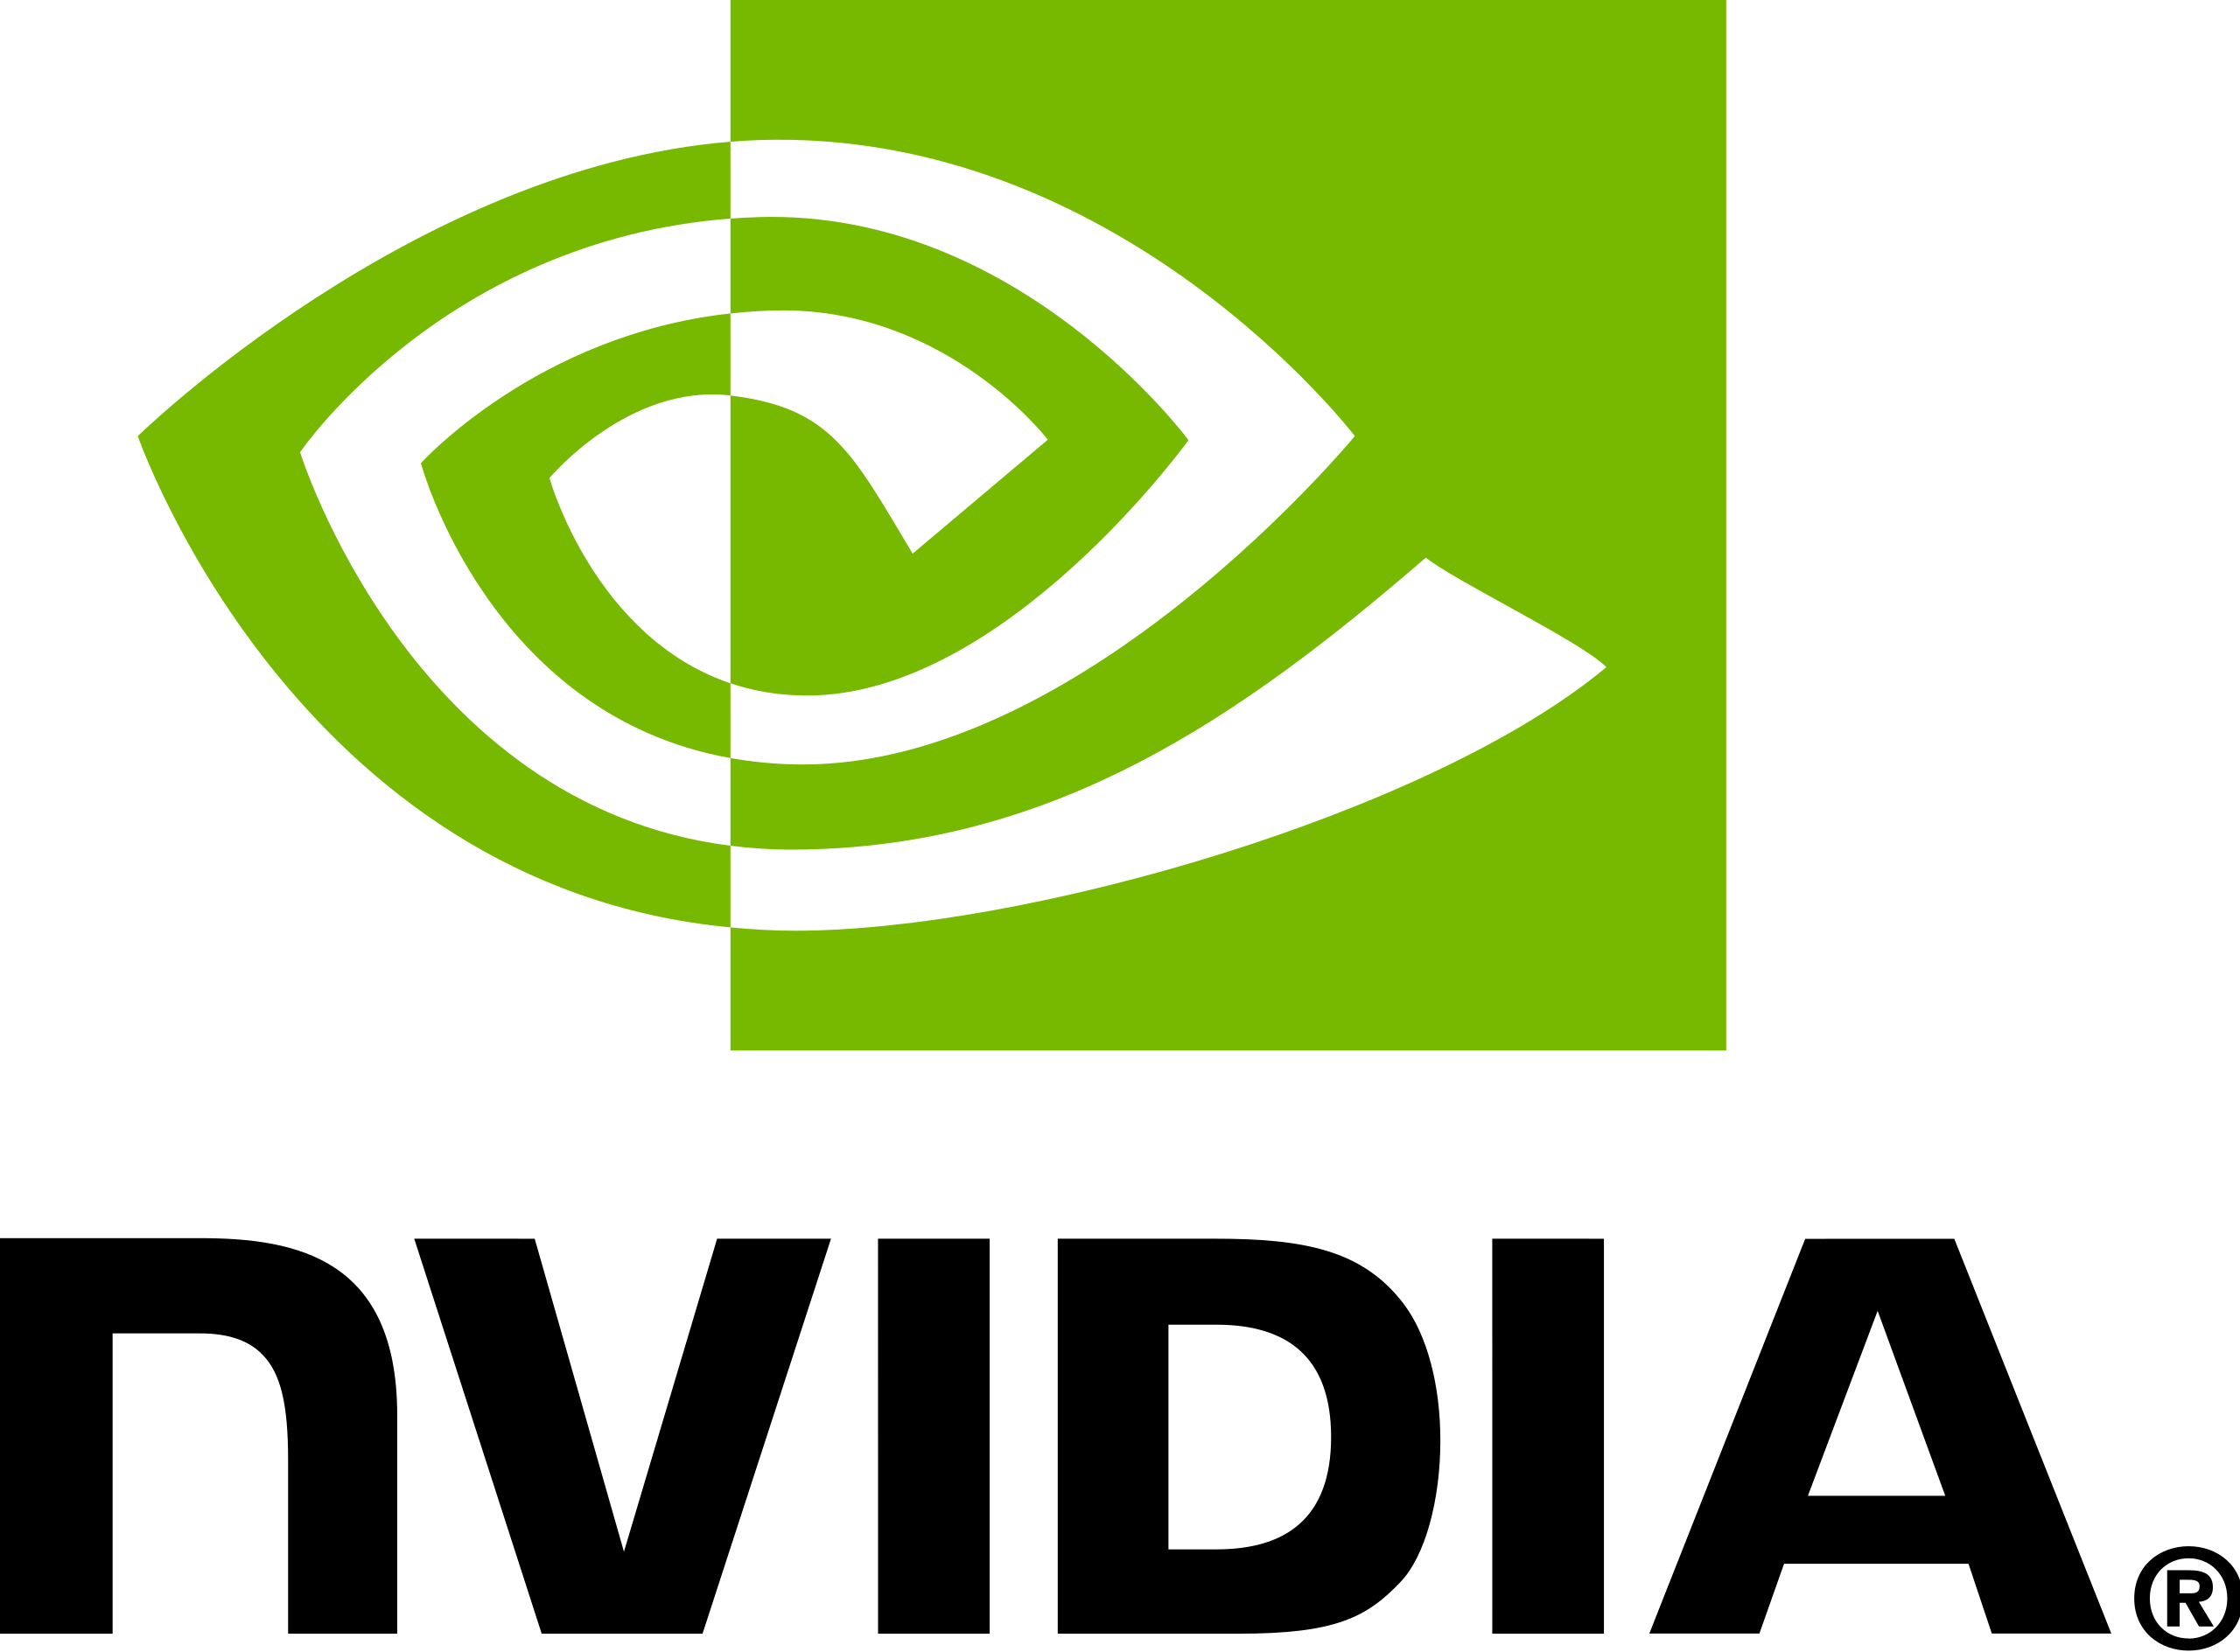
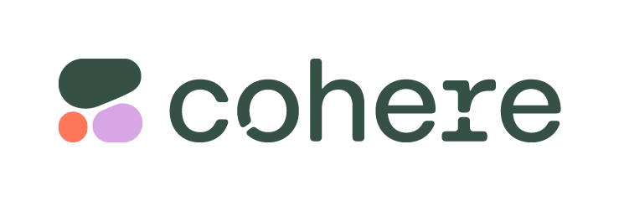




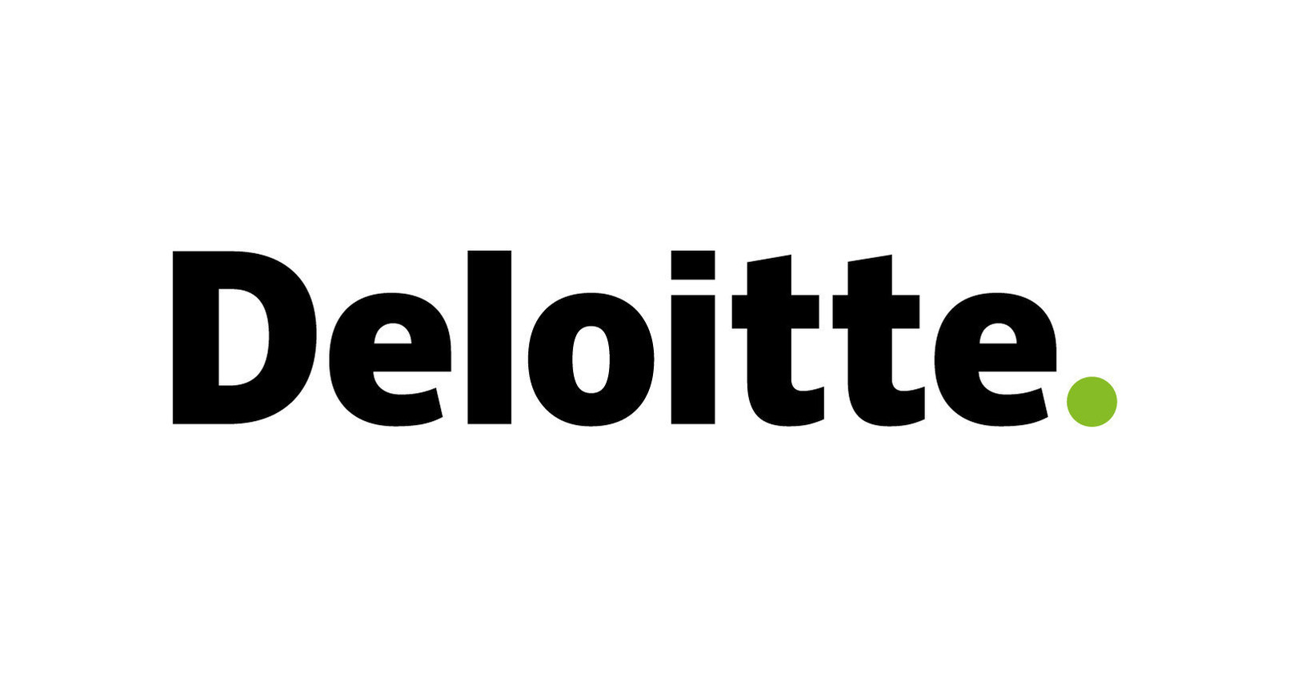









Deloitte will play an orchestrator role across the entire Generative AI ecosystem
FOR INTERNAL USE ONLY
 | AI Visionaries | Model Pioneers | Hyperscalers | Data Marketplace | Application Providers | Orchestrators | Academic Institutions (R&D)
Ecosystem Role | Develop transformative Generative AI products and industry/domain applications | Develop Foundation Models to power Generative AI applications | Provide secure cloud environments and LLM-as-a-service for consumption | Provide curated data to train Foundation Models for new use cases | Consume LLM services to differentiate their applications with Generative AI capabilities | Shape C-Suite agendas, advise and Integrate to Transform using Generative AI | Establish Generative AI Centers of Excellence for co-innovation and talent recruitment
Market Players*
 | Venturing-into| new non-services based business models for emerging markets | Business-with | design and deploy business solutions for clients using Generative AI Foundation Models **Within Independence Guidelines and constraints | Sell-with | build and sell Generative AI Industry/Domain solutions by training models and consuming LLM-as- a service; e.g., Google: FSI, Consumer, Marketing AWS: TMT NVIDIA⁺: LSHC, Auto, Simulations | Access-from |procure propriety data (with legal structures in place) to train models for general fit-for-purpose applications and Industry/Domain Generative AI solutions | Sell To | embed LLMs in their products to differentiate in the market Sell-with | create a differentiated position and Deloitte co-branded offering in the market | Advise | select right partners and models across modalities Implement | transform client organizations by applying Generative AI Operate | run AI factories for continuous consumption, tuning and business value creation through LLM Ops Risk and Trustworthy AI | provide services to shape risk, security and responsible AI | Co-develop | invest in R&D and create a talent pipeline through fellowships, internships, etc.
Indian Institute of Science, Bengaluru
**
Microsoft
**
Deloitte’s Role
⁺ NVIDIA SuperCloud on a Hyperscaler
* Examples are not exhaustive

Slide 19
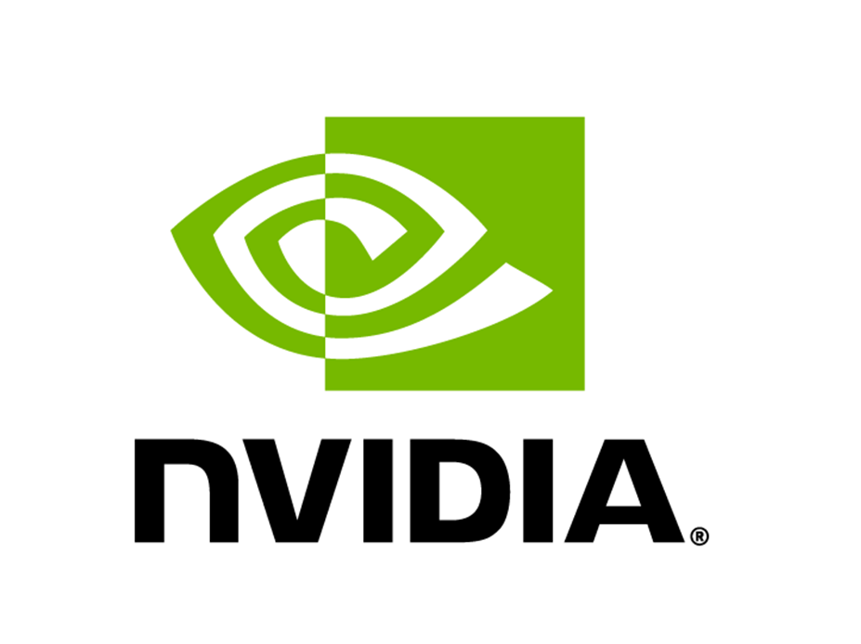









Current Outlook: Generative AI Model Pioneers and Opportunities for Deloitte
MICROSOFT
ALPHABET
NVIDIA
AMAZON
Foundation Models*: Turing-NLG, GPT-3, GPT-4, Whisper, DALL-E
Foundation Models*: Chinchilla, LaMDA, AlphaFold, DreamFusion
Foundation Models*: Megatron-NLG, Get3D, Magic3D
Foundation Models*: Amazon Titan, CodeWhisperer, AlexaTM
ENTITIES*
Owns
Owns
Partners with
Partners with
Inception Program
13,000 Startup incubation
Invests in
Owns
Invests in
Google DeepMind
An Alphabet company
Invests in*
FOCUS AREAS*
GitHub
Content Generation
Human Speech
Human Reasoning
Biology Simulation
Content Generation
Code Generation
Human Reasoning
Content Generation
Human Speech
Biology Simulation
Content Generation
Code Generation
DELOITTE ROLE
Engage with Microsoft and OpenAI as a traditional Technology Services Relationship to deliver AI solutions to clients across industries and domains
Design & deploy business solutions with Google’s Generative AI tools to eliminate constraints of scale, performance, and cost
Help clients build AI solutions such as enhancing customer experiences, optimizing operations and launching innovative businesses in new markets on NVIDIA platforms
Leverage Amazon Bedrock to provide clients with a cost-effective serverless API for AWS customers to build Generative AI applications.
*Lists not exhaustive

Slide 20
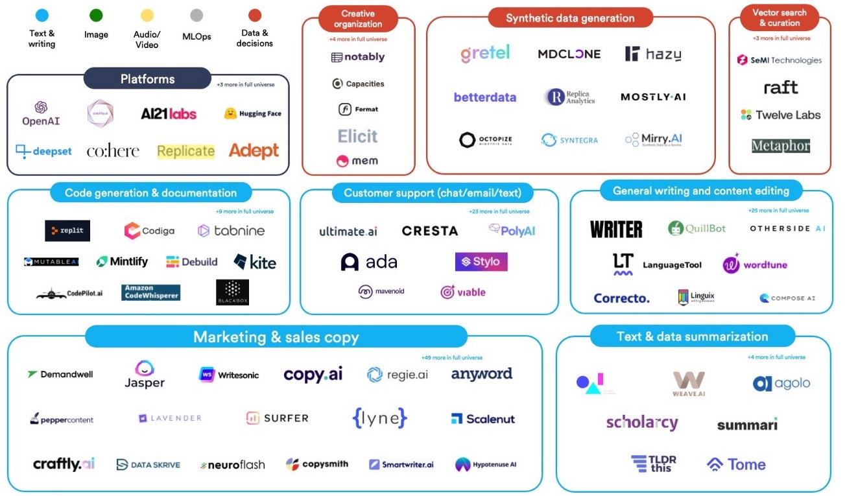


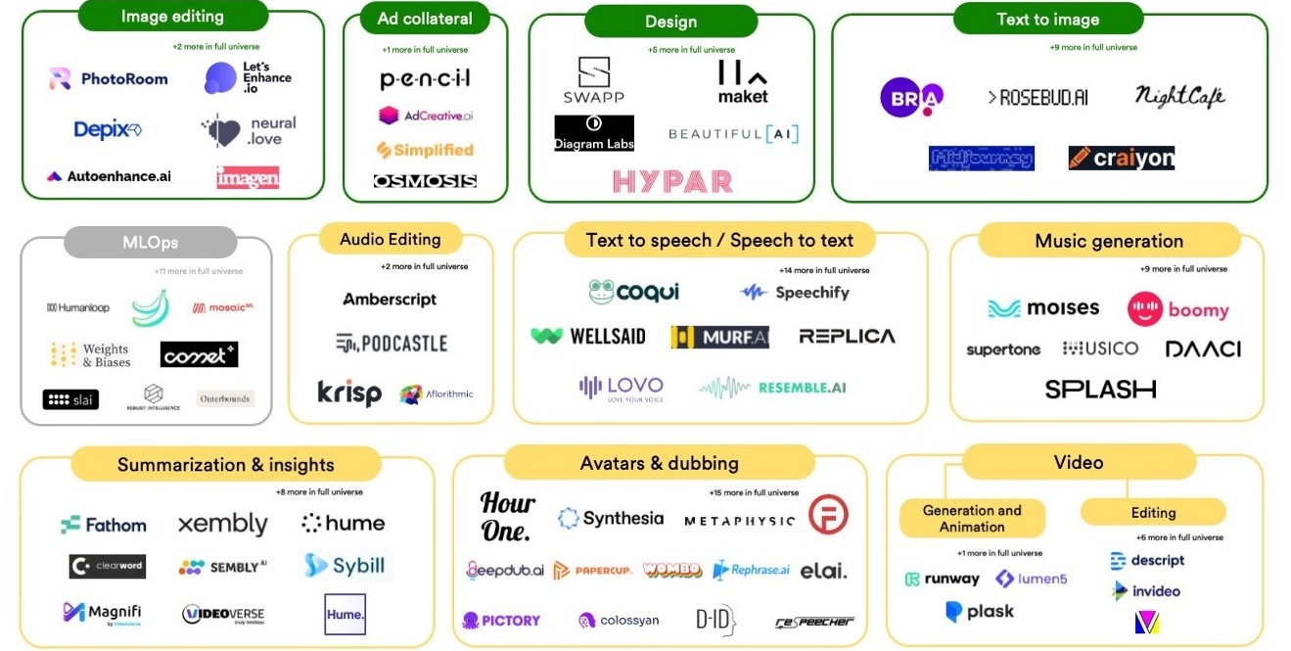




The Generative AI Ecosystem Landscape Comprises a Few Companies Making Foundation Models and Many More Building Applications
A few players have Foundation Models* …
… but it’s a busy application* landscape…
e.g., for generating text, image, video, audio, coding
Microsoft
Beijing Academy of AI
Midjourney
Image Source: : Base10 VC; Sequoia Capital
*Not exhaustive list
… and we anticipate more players to gain market share or undergo acquisition

Slide 21




Overview of Select Generative AI Companies, Models & Applications
Model architectures and performance are continually evolving through investments by each parent organization, allowing Deloitte and our clients to benefit by focusing innovation on building and leveraging the applications powered by models
 | COMPANY | FOUNDATION MODEL |  | PARAMETERS | PRIMARY PURPOSE | SAMPLE APPLICATIONS
 | NVIDIA | Megatron-NLG | Megatron-Turing Natural Language Generation | 530B | Human-like reasoning and thinking to generate outputs | Avatar Cloud Engine: Interactive Digital Avatar
 | Microsoft | Turing-NLG | Megatron-Turing Natural Language Generation | 530B | Human-like reasoning and thinking to generate outputs | Azure Search: Enterprise Search
 | OpenAI | GPT-4 | Generative Pre-trained Transformer v4 | TBD | Human-like text and software code | ChatGPT: Generate Text Codex: Generate Code
 | OpenAI | DALL-E 2 | Generative Pre-trained Transformer v3 | 175B | Professional-grade image and art generation | ChatGPT: Generate Text Whisper: Generate Text (from speech) Codex: Generate Code
 |  |  |  |  |  | Generate images
 | Google | AlphaFold |  | 21M | Shape protein-structure analysis in life sciences | AI-Enabled Drug Discovery: Protein folding prediction
 | Google (DeepMind) | Chinchilla | Language Model for Dialogue Applications | 70B | Democratize AI development and create cost efficient outputs | Sparrow: Generate Text
 | Google | LaMDA |  | 137B | Create applications to replicate human-like speech | Google Assistant: Generate conversations
 | Amazon Web Services | Amazon Titan |  | TBD | Human-like text generation | Generate Text
 | Stability.AI | Stable Diffusion |  | 15B | Predict full atomic protein structures from a single sequence of protein | DreamStudio: Generate Images
 |  | StableLM |  | 7B | Human-like text, image generation, and software code | Released open-source 4/19
 | Beijing Academy of AI | WuDao 2.0 |  | TBD | Human-like reasoning and thinking to generate various modalities | Make videos, draw pictures, retrieve text, perform complex reasoning, etc
 | Baidu | ERNIE Bot |  | 260B | Human-like reasoning and thinking to generate outputs | Ernie Bot: Create multi-modal outputs, and human understanding capabilities
 | Midjourney | Midjourney v5 |  | TBD | Professional-grade image and art generation | Generate images
 | Cohere | Cohere |  | 52B | Conversational AI for various enterprise use cases | Summarize: Provides text summarization capabilities at scale.

Slide 22
Crosswalk of Generative AI Use Cases, Modalities & Models
USE CASES* | Autonomous Defense & Intelligence | Sales & Marketing Materials | Active ‘Debugging’ | Consumer Advertisements |  | Fraud Detection on Customer Calls | 3D Images of Anatomy for Education | GreenTech Simulation
 | Climate Simulation | Short & Long Form Story Scripting | Code Generation Across Programming Languages & Systems | Personalized Healthcare Plans and Treatment Options |  | Training on New Technologies | Product Packaging and Branding designs | Financial Statement Analysis
USE CASES | Personal Robots | Dialogue Generations for Chatbots | Test Automation, Test Scenario Creation | Product Packaging, Description & Branding Design | Personalized Education & Financial Plans | Language Translation For Global E-commerce | 3D Models of Well Sites, Reservoirs, Pipelines | Continuous Training Environment
 | Smart Cities | News & Media Summaries | Documentation of Technical Systems | Personalized Recommender Systems | News & Media Summaries | Retail Customer Interactions | Avatar Cloud Engines | AI-Enabled Healthcare Clinical Surveillance
 | Supply Chain Optimization | Legal & Regulatory Documents | Data Engineering, SQL, munging data’ | Product Description & Reviews | System Diagram Generation | Investment Advice & Wealth Management | Gaming World Creation | Nanomaterial Informatics
 | Market Prediction | Internet Search | Customizing Platforms | Caption and Subtitle Generation | Video Editing / Generation | Customer Sentiment Analysis | Metvaerse 3D Experience | Protein Folding Prediction
 | ARTIFICIAL GENERAL INTELLIGENCE (AGI) | TEXT | CODE | IMAGE | VIDEO | SPEECH | 3D | SPECIALIZED
FOUNDATION MODELS* | NVIDIA, Microsoft: MT-NLG | NVIDIA, Microsoft: MT-NLG | NVIDIA, Microsoft: MT-NLG | OpenAI: DALL-E 2 | OpenAI: Whisper | NVIDIA, Microsoft: MT-NLG | NVIDIA: Get3D | NVIDIA, Microsoft: MT-NLG (fine-tuned for industry)
LARGE LANGUAGE MODELS* | Deepmind: Gato, PaLM, GLaM | OpenAI: GPT-4 | OpenAI: GPT-4 | Beijing Academy of AI: WuDao 2.0 | Meta: Make-a-Video | OpenAI: Whisper |  | Google: AlphaFold
 | Beijing Academy of AI: WuDao 2.0 | Google: Chinchilla, Gopher, LaMDA | Beijing Academy of AI: WuDao 2.0 | Stability AI: Stable Diffusion |  | Google: AudioLM |  | Meta: ESM-2
 | Baidu: ERNIE Bot | AWS: Amazon Titan |  | Midjourney: Midjourney v5 |  |  |  | Beijing Academy of AI: WuDao 2.0
 |  | Big Science: Bloom
 |  | Beijing Academy of AI: WuDao 2.0
 |  | Baidu: ERNIE Bot
 |  | Cohere: Cohere
Research & Development
Commercially Available
Based on: Deloitte research, https://www.sequoiacap.com/article/generative-ai-a-creative-new-world/
*Lists are not exhaustive

Slide 23
Risks and Limitations Associated with Generative AI
There are a variety of performance and operational limitations that enterprises should keep in mind as they use Foundational Models:
The ability of the Foundation Model to provide great output is based on the size of the model (number of parameters, typically going into billions) and the quality & size of the dataset that the model is trained on (petabytes)
The Foundation Model providers generally offer a pay-as-you-go billing mechanism, and the cost per use of sophisticated models is materially significant (e.g., $10K+ to fine tune the biggest model and run large documents through it several times)
The models take time to produce output, which is a key consideration for systems that expect real-time output; especially as you chain your prompts
Average token size limit per model is 2K (approx. 2-2.5 pages), while capping out at 4k tokens in a single call. This limit makes it difficult to process larger documents
While the models are highly accurate, they remain 100% confident when they are wrong implying the need for human-in-the-loop and additional risk considerations
Model Performance
Cost
Latency
Token Size Limits
Hallucination
The models have proven scalable on text based use cases but challenges remain contextualizing information across media types, such as interpreting visual cues on a PowerPoint slide
Is the AI being used in a manner consistent with the purpose of the overall exercise? Is there human in the loop to evaluate AI’s suggestion? It is imperative to follow the Deloitte Technology Trust Ethics (TTE) Framework
AI application leverage global data, which raises legal questions related to cross-border transfer privacy laws. The alliance partners have been vetted on the best-in-class controls
Contracts must be written with IP at top of mind, as AI solutions built on Foundation Model require a large ecosystem of vendors to operationalize
It is critical to proactively minimize risk from malicious behavior on the network to maintain operations and customer trust
Going Beyond Text
Ethical Use
Privacy
IP Protection
Adversarial Behavior

Slide 24
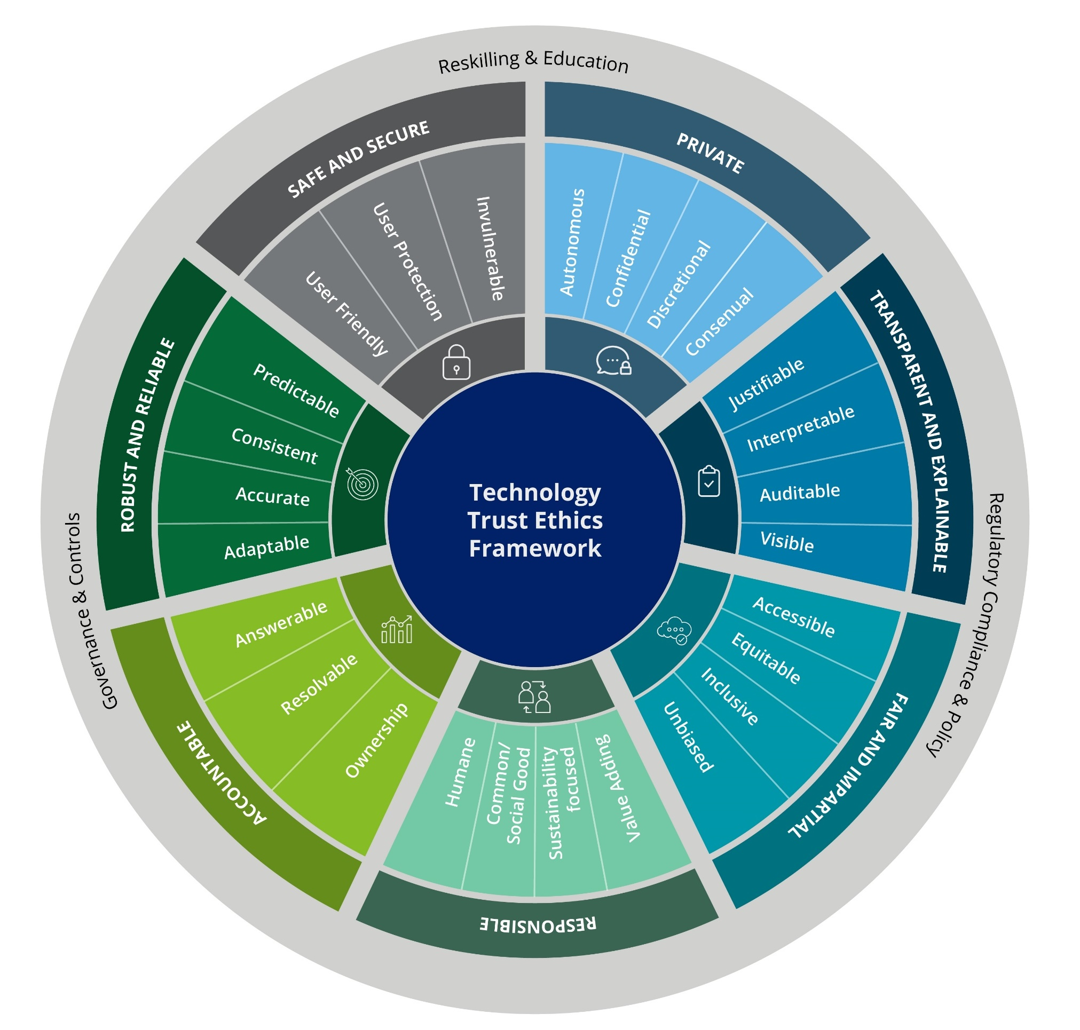
FOR INTERNAL USE ONLY
Technology Trust Ethics (TTE) Framework to Build, Deploy & Commercialize Generative AI Applications
Private
User privacy is respected, and data is not used or stored beyond its intended and stated use and duration; users are able to opt-in / out of sharing their data.
Accountable
Policies are in place to determine who is responsible for the decisions made or derived with the use of technology.
Transparent & Explainable
Users understand how technology is being leveraged, particularly in making decisions; these decisions are easy to understand, auditable, and open to inspection.
Robust & Reliable
The technology produces consistent and accurate outputs, withstands errors, and recovers quickly from unforeseen disruptions and misuse.
Fair & Impartial
The technology is designed and operated inclusively in an aim for equitable application, access, and outcomes.
Safe & Secure
The technology is protected from risks that may cause individual and / or collective physical, emotional, environmental, and/or digital harm.
Responsible
The technology is created and operated in a socially responsible manner.
The framework can be leveraged for all technologies including AI, data, Non-Fungible Token (NFT), Metaverse, 5G, Quantum computing etc.

Slide 25
Generative AI Market Plays

Slide 26






Generative AI Market Plays
Autonomous code generation for enhanced productivity | Autonomous content generation for experiences | Application of FMs¹ for industry/domain solutions
Autonomous Coding
Content & Personalization
Industry/Domain Specific
Impact
Increasing Earnings
Accelerating Growth
Shaping New Markets
Software Engineering Productivity Delivery Pools Engineer Training | Major Players
Content Generation Insight Generation Experience Generation | Major Players
Major Players
Industry specific context generation Domain specific context generation
Focus
NVIDIA
OpenAI
NVIDIA
Invests in
OpenAI
Owns
GitHub
OpenAI
Software Code Generation
Test Case Development and Testing
Legacy Code Translation
Software Audits
Product Documentation and Training
Modern Advise / Strategy Copilot
Ad Generation
Customer Interactions
Enterprise Simulation
Internet / Enterprise Search
AI-Enabled Drug Discovery
Autonomous Mobility Simulation
Financial Statement Analysis
Cyber Threat and Vulnerability Management
Illustrative Use Cases
Software development protocols and practices instituted in delivery centers
Evolving maturity and accuracy
Independence of key technology companies
3-tier Risk Management System to monitor:
Trust | Trustworthy Tech Ethics
Risk | Council of AI Leaders from the business
Anti-Bias | Review and Oversight with Quality & Risk Management (QRM) and Audit council
Access to industry/domain specific training data sets
Government security & controls
Risk Considerations
PRE-REQUISITES:
Data in the Cloud
AI Infrastructure Software
Graphics Processing Unit (GPU) Chips, Tensor Processing Unit (TPU)
¹FM: Foundation Model, AI model that is trained on broad data (generally using self-supervision at scale) that can be adapted (e.g., fine-tuned) to a wide range of downstream tasks e.g., Large Language models
OP-owned
Industry-owned

Slide 27
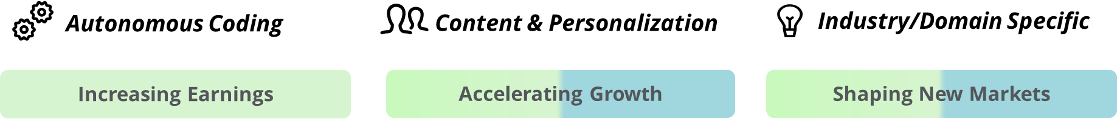





Autonomous Coding
Autonomous code generation for enhanced productivity
FOR INTERNAL USE ONLY
ILLUSTRATIVE USE CASES
MARKET LEADERS AND START-UPS
IMPLICATIONS FOR DELOITTE
By Development Lifecycle
Framework evaluation & comparison, research, code reviews, code assessment, quality checks, diagram generation
Code generation across programming languages, frameworks and hyperscalers
Documentation – requirements, design and architecture docs, tutorials, API usage guides, user guides, etc.
Test automation, test scenario creation
Support DevOps, Infra as code, scripts, CI/CD
Data engineering, SQL, munging data
Active ‘Debugging’
Simulations / variations
Operational scripts provisioning / scheduling / fault detection, etc.
By Workload / Application Type
Training on new technologies
Start-up kit for simpler problems
Expanded domain use cases/code libraries
Peer review – optimized code writing
Program synthesis
Legacy code summarization & translation, rewrite to another language
Customizing platforms – MuleSoft, SAP, Salesforce, ServiceNow, etc.
Advise
Creation of newer streams of business / product development
Ability for rapid prototyping (e.g., DigiPrint for clients)
Implement
Increased software engineer staffing flexibility across programming languages, frameworks, and hyperscalers
Operate
Lower barrier to entry for new competitors with ISVs (e.g., ServiceNow/SAP/etc.)
Unclear IP protection and legal status impacts
MARKET LEADERS
Invests in
OpenAI
Autonomous Database delivers automated database maintenance
Codex for autocomplete
Owns
GitHub
Copilot to co-write code with programmer
CodeWhisperer provides first class support for AWS APIs
DEMO
AlphaCode for competitive programing
Autonomous Coding
START-UPS
AIXCoder for code generation and code completion
Tabnine provides whole-line & full-function code completions
Codiga provides automated code / security analysis
GitHub Copilot X
¹Codex is currently US asset, being evaluated for Global SAM pilot
NOTE: Apply the Deloitte Technology, Trust and Ethics (TTE) Framework when building autonomous coding assets

Slide 28

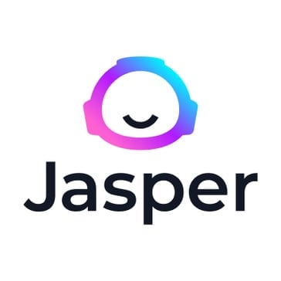
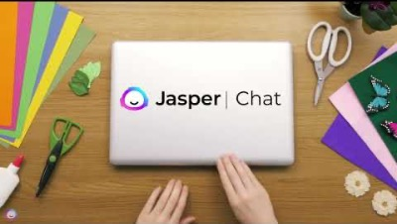
Content & Personalization
Autonomous content generation for experiences
FOR INTERNAL USE ONLY
ILLUSTRATIVE USE CASES
MARKET LEADERS AND START-UPS
IMPLICATIONS FOR DELOITTE
Content
Sales & Marketing Materials
Metaverse 3D Experience
Internet Search
Legal & Regulatory Documents
News & Media Summaries
Image, Video, Audio and Music
Short & Long Form Story Scripting
Caption and Subtitle Generation
Web Design & Development
Financial Reports & Analysis
Product Description & Reviews
Brand Strategy Development
Video Editing / Generation
Gaming World Creation
Personalization
Consumer Advertisements
Recommender Systems for E-Commerce and Streaming Platform
Dialogue Generation for Chatbots and Virtual Assistants
3D Virtual Avatar Creation (Avatar Cloud Engines)
Personalized Healthcare Plans and Treatment Options
Personalized Education & Financial Plans
Public engagement / strategic communications
Fraud Detection on Customer Calls
Investment Advice & Wealth Management
MARKET LEADERS
Advise
Enhance competitiveness, quality, and differentiation of what is sold
Offer new services to clients to help them re-vector their talent pool and enhance productivity
Consider impact on contracts as more and more client deliverables could be generated by Generative AI as opposed to standard staffing
Implement
Create efficient and more tailored solutions for clients
Operate
N/A
Make-A-Video: Text to Video Generation
2D & 3D Content Generation
Internet Search (Bing by GPT-3)
Various Generative AI Use Cases offered as a service
Natural Language Processing (NLP) Tasks & Text-to-Image generation.
Invested by Microsoft
START-UPS
DEMO
Search Engine Optimization (SEO) optimized blog posts, copy, summaries
Natural Language Processing (NLP) toolkit and language model for developers. Part of NVIDIA inception program
Copywriting across mediums using GPT-3
Content for digital ad, sales, social media, ecommerce
Open–source models for language and image generation
Cyber Threat Detection and Response.
Uses Microsoft Amazon Web Services (AWS)
Jasper Chat
Indicates co-development or investment
NOTE: Apply the Deloitte Technology, Trust and Ethics (TTE) Framework when building Generative AI applications to create content

Slide 29
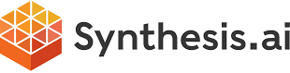


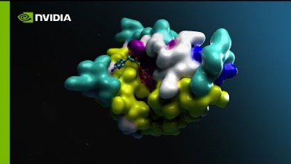


Industry/Domain Specific
Application of Foundation Models for industry and domain context generating solutions
FOR INTERNAL USE ONLY
ILLUSTRATIVE USE CASES
MARKET LEADERS AND START-UPS
IMPLICATIONS FOR DELOITTE
Life Sciences & Healthcare
Protein Folding Prediction (AI-Enabled Drug Discovery)
AI-Enabled Healthcare Clinical Surveillance (Care-to-Cure)
3D Images of Anatomy for Education
Consumer
Customer Sentiment Analysis
Product Packaging, Description & Branding Design
Language Translation For Global E-commerce
Continuous training environment (Autonomous Mobility Simulation)
Energy, Resources & Industrials
3D Models of Well Sites, Reservoirs, Pipelines
Nanomaterial Informatics
GreenTech Simulation
Financial Services
Fraud Detection on Customer Calls
Retail Branch Customer Interactions
Tech Media & Telecom
Disaster Recovery Simulation
Audit, Tax & Risk Advisory
Financial Statement Analysis
K-1 Extracts
Cyber Threat Vulnerability Management
Government and Public services
Fraud, Waste & Abuse Prevention
Regulation & Oversight
Open Source Intelligence & Sensemaking
MARKET LEADERS
Advise
Enhance competitiveness, quality, and differentiation of what is sold
Implement
Curate privileged partnerships with market leaders and start-up ecosystem
Ensure the models are ethical, transparent, and compliant with relevant regulations and industry standards
Operate
Work with the privileged partners to fine tune, train and shape models for industry and domain specific applications
Creating application frameworks for customers to fine-tune models for Industry and Domain use cases
START-UPS
Synthetic data generation (humans and scenarios); part of NVIDIA inception program
Virtual try-on and product discovery
Creates quantitative reports on qualitative customer feedback
DEMO
Accelerating drug discovery; part of NVIDIA inception program
AI models for Image, Language, Audio, Video, 3D and Biology
NVIDIA BioNemo
Indicates co-development or investment
NOTE: Apply the Deloitte Technology, Trust and Ethics (TTE) Framework when training industry/domain specific FMs

Slide 30






The Generative AI Dossier: Selected Use Cases
 | Energy, Resources, and Industrials | Financial Services and Insurance | Government and Public Services | Tech, Media, and Telecom | Life Sciences and Healthcare | Consumer
Audio | Field Virtual Assistant Enable field agents to access best practices and repair information using natural language while hands-free | Retail Banking Transaction Support Provide human-like support for complex retail transactions including customer applications, questions, negotiations, and more | Intelligent Agents / Student Office Hours Provide natural language support for government services and on-demand access to information for students | Translations, Subtitles, and Descriptions Translate audio into multiple languages (e.g., subtitle generation) and provide descriptions to visual media content | Automated Follow-Ups Ingest clinical notes to identify patients that will need follow-up and create audio messages that can be sent to schedule follow-ups and encourage healthy habits | Conversational Retail Provide detailed product support and guidance using human-like chatbots in retail stores focused on specific brands and/or categories
Code | No-Code Physics-Based Environments Allow researchers to create highly computational and accurate physics-based models of weather, fluid dynamics, and environments | Database Search Query massive financial transaction databases to find specific items and insights using natural language instead of database languages such as SQL | Knowledge Management Allow government workers to cluster, search, and filter large amounts of unstructured data from images, video, and text files through natural language | Original Games Creation Ideate and code novel computer and video games and accelerate the game testing process | Clinical Trial Data Processing Allow researchers to clean up data and generate graphs and insights for clinical trials and approvals processes using natural language | Marketing Speed Help marketers build websites and external collateral at the speed of natural language to go-to-market faster with new products and services
Image | New Product Development Create detailed schematic drawings of industrial products and parts to aid in new product development and repairs | Fraud Detection Generate customer signatures to enhance internal fraud models in areas such as credit card authorization, and summarize potential fraud hotspots | Infrastructure Mapping Enhance infrastructure mapping and planning processes by generating detailed plans and iterating using natural language | Semiconductor Chip Design Iterate and enhance designs based on performance parameters and reduce the development life cycle time | Improved Medical Imaging Generate large sets of synthetic medical images to train imaging algorithms to better identify abnormalities as well as train clinicians to better identify issues | Product Photography and Details Generate details and ultra-realistic photographs of new and existing products in different environments
Text | Technical Document Summarization Extract information from detailed documentation and synthesize field-reports in specific formats | Customer Due Diligence Reporting Generate reports on new customers such as KYC processes and summarize them for employees to action and make decisions for customer onboarding | Intelligent Case Management Parse complex government case files for actionable details which are then summarized for rapid comprehension and used to generate reports | Cybersecurity Threat Detection Summarize areas of high-risk, answer questions, and generate executive reports for malware, anomalies, and potential threats | Medical History Summary Summarize patient demographics, medical history, allergies, medications, and other relevant details from EHR clinical notes to aid hospital intake | Personalized Supermarket Create custom meal plans and shopping lists fine-tuned for each buyer/family specific to the store and what’s available
Video (Early Stages) | Event Identification Absorb live video feeds of the end-to-end production chain and answer specific questions about processes and events | Claims Footage Review video footage of claims (e.g., car crashes) to pull out summaries and eventually generate new video of potential crash scenarios | Citizen Support Provide hyper-realistic, life-like personal assistants in places such as the airport, DMV, border patrol and immigration, to support citizen needs | Virtual Anchors Create virtual on-air anchors for high-demand events (e.g., live sports) where there are not enough people to support across languages/borders | Digital Therapy AR/VR content generation for assets required in digital therapy or virtual environments | Commercial Brainstorming Rapidly brainstorm with generated video and video storyboards for pieces such as television/online commercials
3D Models & Data | Geological Assessments Assess both real and synthetic data for oil exploration and the likelihood of finding resources | Financial Model Enhancement Generate synthetic data to improve and enhance financial models and pressure test an institution’s liquidity and processes | Disaster Recovery and Planning Support urban planners and disaster recovery teams with synthetic data (e.g., traffic, population, ‘what-if scenarios’) to aid in planning and preparation | Telecom Network Maintenance Train digital twins on synthetic data to help identify network faults and provide remediations for on-field technicians | New Drug Discovery Generate the structure and function of proteins and biomolecules, accelerating the creation of new drug candidates | Rapid Product Design / Consumer Preferences Accelerate product prototyping lifecycle through creation of unique and high-fidelity product mock-ups, and create synthetic behavioral data of buyers
Industry
Modalities
We are publishing a Generative AI Dossier in late June that will cover prominent applications of the technology across all industries. In addition, each use case will be evaluated using Deloitte’s Technology Trust Ethics (TTE) Framework to help organizations implement them in a safe and trustworthy manner
Privileged and confidential – Do not share

Slide 31
Appendix

Slide 32




FOR INTERNAL USE ONLY
Competitor Summary: Consulting Firms
Competitor | Practices / Offerings | Major Investments | Partnerships
 | Bain Vector is an integrated delivery platform that combines AI, IoT, cybersecurity, automation and blockchain | Capabilities for Advanced Analytics and ML solutions in different industries | Alliance with OpenAI, Endava and more
 | BCG GAMMA is building capabilities throughout the ML value chain as well as AI/ML applications. It is creating a library of AI models and applications for clients | Gamma capabilities with vertical solutions in certain practices like mining. Broaden software offering for clients | Alliance with OpenAI and major companies e.g., AWS, Microsoft, Wipro, Adobe, Google Cloud, Meta, Salesforce, SAP
 | Quantum Black develops proprietary tools focusing on vertical and horizontal functional applications in various industries: Retail, Metals & Mining, Financial Services, Tech, Telecom, Life Sciences, Sport | Data architecture, ML, cloud solutions and data engineering capabilities, vertical solutions (SG4 acquisition) in certain products | Alliances with major companies e.g., Microsoft, Salesforce, Workday
 | Solutions.AI is a collection of AI solutions built on AI expertise, data services, intellectual property and ecosystem partners | Capabilities in market research, consumer insights, big data analytics, cloud consulting, semiconductor engineering, carbon emission, data management | Alliances with major companies e.g., Alibaba, Facebook, Google, Microsoft, SAP, Salesforce, Adobe
 | Modern Data Platform (MDP) is a curated cloud-native solution. IGNITE brings together specialists and NLP, ML, deep learning, document ingestion and optical character recognition. Signals is an active listening platform that converts data into signals to improve forecast and modelling | Enterprise software integration and automation services | Alliances with major companies e.g., Alibaba, IBM, Google Cloud, Microsoft, Oracle
 | EY Aspace is an enterprise AI and automation platform | Data science & analytic, robotics capabilities | Alliances with major companies e.g., Adobe, IBM, Microsoft, SAP, Snowflake
 | AI Services offers expertise and experience with natural language processing, machine learning, deep learning, model operations, automated ML, digital twins, generative AI, embodied AI, responsible AI, and more. | Data science & analytics capabilities, ​​predictive analytics, cloud services, data analysis business analytics | Alliances with major companies e.g., SAP, Oracle, Salesforce, Microsoft, AWS

Slide 33





FOR INTERNAL USE ONLY
Competitor Summary: Niche AI and Data Science Firms / System Integrators
Competitor | Practices / Offerings | Major Investments | Partnerships
 | Mu Sigma combines data engineering, data science, and decision science to support client decisions | Advance analytics, digital transformation, data engineering, customer analytics, risk analytics. No recent acquisitions. | Google
 | Senseforth.ai is a conversational AI platform for enterprises | AI, ML, customer intelligence, marketing analytics, data engineering. Recent acquisitions include Neal Analytics to scale on AI | AWS, Google Cloud, Microsoft, Twitter, Snowflake and more
 | Wipro Holmes is AI-powered customizable solutions for business leaders | Digital technologies, cybersecurity, industry-specific solutions, sustainability, talent. Recent acquisitions include Ampion, a provider of cybersecurity services, and Capco, a global management and technology consultancy | AWS, dataiku, databricks, Google Cloud, IBM and more
 | Tata Elxsi is a design and technology service providers across industries, including Automotive, Broadcast, Communications, Healthcare, and Transportation. | IoT, Cloud, Mobility, Virtual Reality, AI. Recent acquisition include 1mg, a healthcare platform based in India. | Microsoft, AWS, Cisco
 | Applied AI Offerings range from AI Consulting, AIOps, Conversational AI and more | Recent acquisitions include Simplus, a Salesforce consulting and advisory firm, and GuideVision, a ServiceNow partner. These acquisitions were aimed at expanding Infosys' capabilities in digital transformation and cloud services | Microsoft, Google Cloud, IBM, Dell, Databricks, Cisco and more

Slide 34
Industry-Specific Market Plays

Slide 35

Generative AI Market Plays - GPS
Autonomous code generation for enhanced productivity | Autonomous content generation for experiences | Application of FMs¹ for industry/domain solutions
Autonomous Coding
Content & Personalization
Industry/Domain Specific
Impact
Increasing Earnings
Accelerating Growth
Shaping New Markets
Software Engineering Productivity Delivery Pools Engineer Training | Major Players
Content Generation Insight Generation Fraud Threats | Major Players
Major Players
Scientific applications Healthcare Commercialization of Space
Focus
NVIDIA
OpenAI
NVIDIA
DeepMind (Alphabet)
OpenAI
Invests in
OpenAI
Owns
GitHub
Software Code Generation
Test Case Development and Testing
Legacy Code Translation
Software Audits
Product Documentation and Training
Public engagement / strategic communications
Open Source Intelligence
Metaverse 3D Experience
Fraud detection & prevention
Enterprise Knowledge Management
AI-Enabled Drug Discovery
Autonomous Mobility Simulation
Material Science
Climate and Natural resources
Space Operations and Awareness
Illustrative Use Cases
Software development protocols and practices instituted in delivery centers
Evolving maturity and accuracy
Independence of key technology companies
3-tier Risk Management System to monitor:
Trust | Trustworthy Tech Ethics
Risk | Council of AI Leaders from the business
Anti-Bias | Review and Oversight with Quality & Risk Management (QRM) and Audit council
Risk Considerations
Access to domain, government and classified training data sets
Government security & controls
PRE-REQUISITES: Data in the Cloud AI Infrastructure Software Graphics Processing Unit (GPU) Chips
¹FM: Foundation Model
OP-owned
Industry-owned

Slide 36

For all questions and inquires, contact:
Global Generative AI Clearinghouse

Slide 37

Deloitte refers to one or more of Deloitte Touche Tohmatsu Limited (“DTTL”), its global network of member firms, and their related entities (collectively, the “Deloitte organization”). DTTL (also referred to as “Deloitte Global”) and each of its member firms and related entities are legally separate and independent entities, which cannot obligate or bind each other in respect of third parties. DTTL and each DTTL member firm and related entity is liable only for its own acts and omissions, and not those of each other. DTTL does not provide services to clients. Please see www.deloitte.com/about to learn more.
This communication and any attachment to it is for internal distribution among personnel of Deloitte Touche Tohmatsu Limited (“DTTL”), its global network of member firms and their related entities (collectively, the “Deloitte organization”). It may contain confidential information and is intended solely for the use of the individual or entity to whom it is addressed. If you are not the intended recipient, please notify us immediately by replying to this email and then please delete this communication and all copies of it on your system. Please do not use this communication in any way.
None of DTTL, its member firms, related entities, employees or agents shall be responsible for any loss or damage whatsoever arising directly or indirectly in connection with any person relying on this communication. DTTL and each of its member firms, and their related entities, are legally separate and independent entities.
© 2023. For information, contact Deloitte Global.

